Slide 1
Week 8
Database Security – Part 1

Slide 2
Student Objectives
Upon completion of this video, you should be able to:
Create a user in mysql and assign the user a password
Using the mysql database, list the users
Grant the user some privileges
List at least 5 privileges in MySQL
Revoke privileges from a user
Using the system catalog, list all the privileges

Slide 3
Database Security
Legal/Ethical Issues (right to privacy of information, ...)
Policy Issues (what does your company make available; who within the company should be updating what)
System Issues (where and how should security be handled? Physical hardware level, operating system level, DBMS level) →we will look at this one!

Slide 4
2 Types of Database Security Mechanisms:
Discretionary: grant privileges to users on tables, records, fields, etc. based on the discretion of the owner of the table (what you’re used to in Unix)
Mandatory: Multiple security levels, categorize the data and the users on the levels; decisions of who gets to see what are based only on relative levels/security labels (example: Top Secret, Secret, Confidential, Unclassified)

Slide 5
Database Security and the DBA
DBA has a system account (like a superuser). The DBA account performs the following actions
Account Creation (sets account name, password)
Privilege Granting
Privilege Revocation
Security Level Assignments (set user account to appropriate security classification)
User must log on to DBMS using an account name and password
All actions by the user are monitored in a log file
If anything suspicious occurs a database audit is performed to check actions and accounts

Slide 6
Discretionary Access Control
Grant and revoke privileges from users, 2 levels
Account Level: giving the user access to the database in general
CREATE SCHEMA
CREATE TABLE
CREATE VIEW
ALTER, DELETE, MODIFY, SELECT

Slide 7
Relation Level: giving the user access to each relation in the database
Each relation R is assigned an owner account (usually the account that created the relation in the first place). The owner account is given all privileges on that relation. This owner can pass on privileges to other users by granting privileges to their accounts
SELECT privilege on R → Account can only retrieve from R
MODIFY privilege on R (divided into UPDATE, DELETE and INSERT privileges). With the Insert and Update you can restrict to just certain attributes
References privilege on R → Used for creating integrity constraints

Slide 8
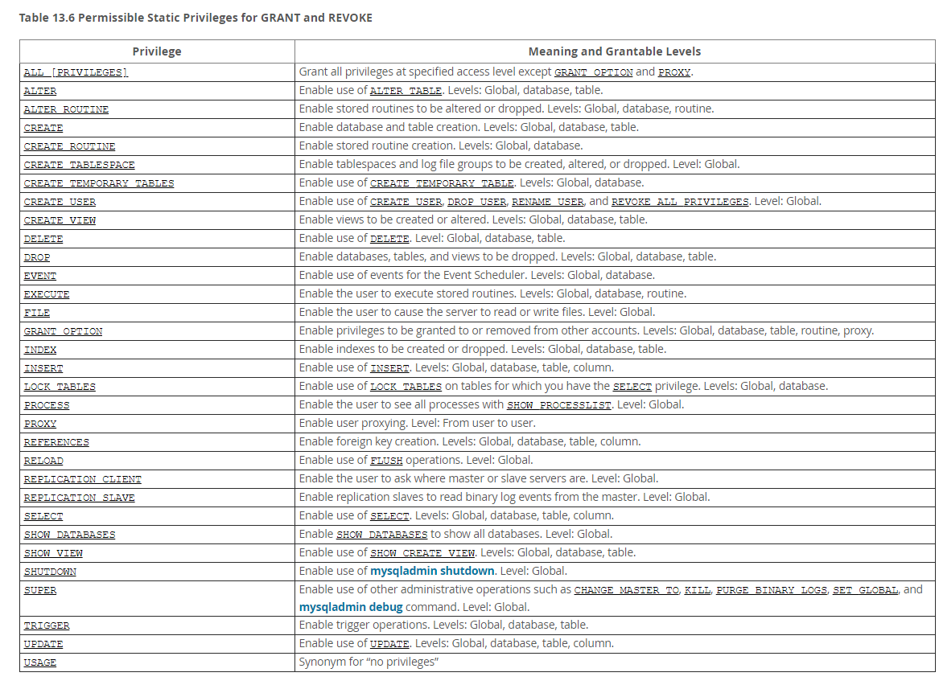

Slide 9
Creating Users
OR (for a user with no password) → WEAKEST
CREATE USER 'jeffrey'@'localhost';
OR → WEAK
CREATE USER ‘lreid’@’localhost’ identified by ‘mypass’;
OR → STRONGEST
CREATE USER 'jeffrey'@'localhost' IDENTIFIED BY PASSWORD ‘*90E462C37378CED12064BB3388827D2BA3A9B689';
(This one is because if you do the first one, the actual password will go into the log file and it can be viewed)
To remove a user that you have created use the DROP command:
DROP USER ‘jeffery’@’localhost’;

Slide 10
DB Privileges SQL Commands
REVOKE → removes privileges
GRANT → adds privileges
WITH GRANT OPTION → allows one user to give another user the ability to give other users privileges

Slide 11
Question: Can you figure out what these commands might do?
GRANT ALL ON mydb.* TO 'someuser'@'somehost';
GRANT SELECT, INSERT ON mydb.* TO 'someuser'@'somehost';
GRANT SELECT, INSERT ON mydb.mytbl TO 'someuser'@'somehost';
GRANT SELECT (col1), INSERT (col1,col2) ON mydb.mytbl TO 'someuser'@'somehost';
We did something like this in assignment 2 already:
DROP USER 'ta'@'localhost'; CREATE USER 'ta'@'localhost' IDENTIFIED BY ‘somepassword'; GRANT ALL PRIVILEGES ON yourwesternuseridassign2db.* TO 'ta'@'localhost'; FLUSH PRIVILEGES;

Slide 12
EXAMPLES:
Assume that:
EMPLOYEE, PROJECT are my tables
lreid, sskinner, nflanders, hsimpson, mburns are users
BIRTHDATE, SALARY and NAME are some of the columns from the table EMPLOYEE

Slide 13
Suppose that nflanders does the following:
GRANT INSERT,DELETE ON employee, project TO lreid;
Suppose then that nflanders does this command:
GRANT SELECT ON employee, project TO hsimpson WITH GRANT OPTION;
Suppose then that hsimpson does this command
GRANT SELECT ON employee TO mburns;
QUESTION: What do you think happens when this command is executed:
REVOKE SELECT on EMPLOYEE from hsimpson;

Slide 14
Suppose we only want sskinner to see the birthdate and name of employees but not salaries or other info for the Payroll department (then we would do the following:)
CREATE VIEW vlimitemp as SELECT name, bdate FROM employee WHERE DeptNo = ‘5’;
QUESTION: Then what would we do?
QUESTION: What do you think this statement does:
GRANT UPDATE ON Employee(Salary) TO bgumbel;
ANSWER:
GRANT SELECT ON vlimitemp TO sskinner;
ANSWER:
bgumbel can only update the salaries but no other fields!

Slide 15
Can also create VIEWS → if you want a user to only see column A from table AAA and column B from table BBB you can create a view and give the user access to the view

Slide 16
Example from the System Tables:
mysql> select * from USER_PRIVILEGES;
+-------------------+---------------+----------------+--------------+
| GRANTEE | TABLE_CATALOG | PRIVILEGE_TYPE | IS_GRANTABLE |
+-------------------+---------------+----------------+--------------+
| 'root'@'localhost‘| def | SELECT | YES |
| 'root'@'localhost‘| def | INSERT | YES |
| 'root'@'localhost‘| def | UPDATE | YES |
| 'root'@'localhost’| def | DELETE | YES |
| 'root'@'localhost’| def | CREATE | YES |
…
mysql> select * from TABLE_PRIVILEGES;
+----------------+---------------+--------------+------------+----------------+--------------+
| GRANTEE | TABLE_CATALOG | TABLE_SCHEMA | TABLE_NAME | PRIVILEGE_TYPE | IS_GRANTABLE |
+----------------+---------------+--------------+------------+----------------+--------------+
| ''@'localhost' | def | vetdb | owner | SELECT | NO |
| ''@'localhost' | def | vetdb | owner | INSERT | NO |
| ''@'localhost' | def | vetdb | owner | UPDATE | NO |
| ''@'localhost' | def | vetdb | owner | DELETE | NO |
| ''@'localhost' | def | vetdb | owner | CREATE | NO |
| ''@'localhost' | def | vetdb | owner | DROP | NO |
| ''@'localhost' | def | vetdb | owner | REFERENCES | NO |
….

